Slide 1
Chapter 3 - Signature

Slide 2
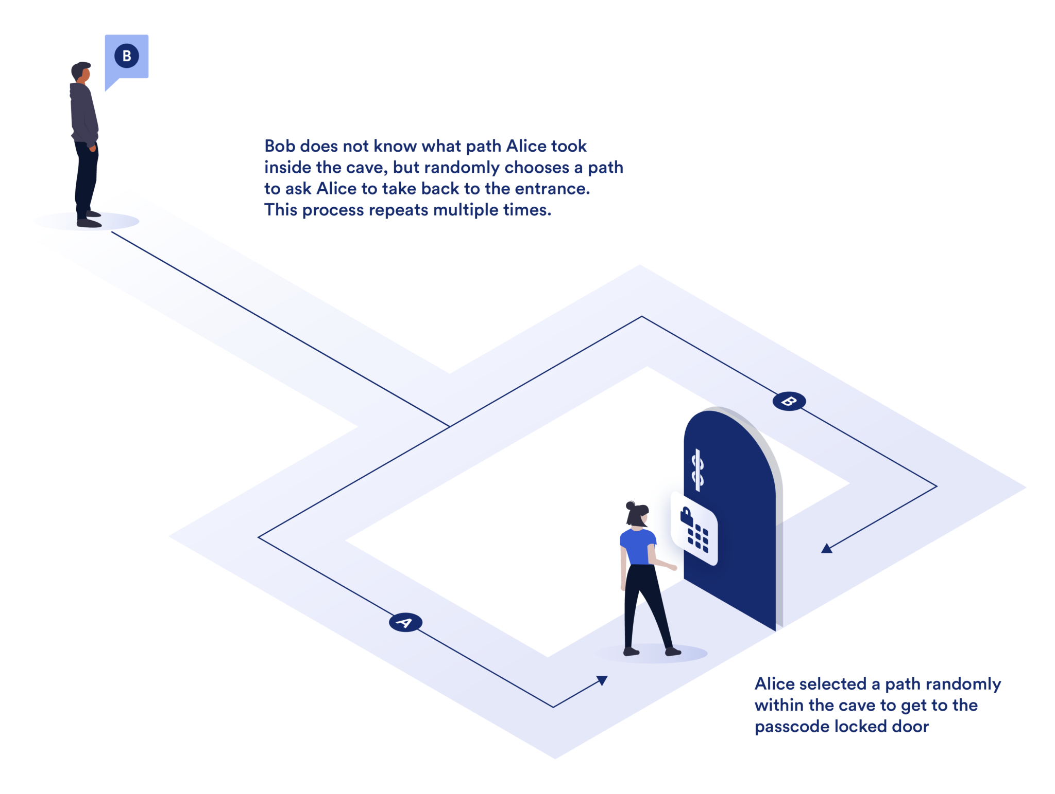
Section 3.1 - Σ-protocols and the Fiat-Shamir Heuristic
Interactive Proof of Knowledge
Zero-knowledge
Legitimate prover knows (x, w)

Slide 3
Endomorphism Ring
An endomorphism given an elliptic curve is an isogeny (mapping), φ : E → E
The collection of all endomorphisms along with addition and noncommutative multiplication for the endomorphism ring of an elliptic curve
(f+g)(P) = f(P) + g(P)
(f o g)(P) =f(g(P))

Slide 4
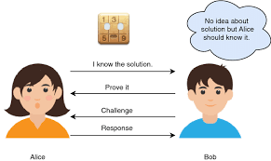
Three interactive phases
Public key: E_{A}
Private key (knowledge): End(E_{A})
Commitment: Prover randomly generates (E₁, End(E₁)). Sends E₁ to verifier.
Challenge: Verifier randomly generates φ_{chall} : E₁ → E₂ and sends φ_{chall} to prover.
Response: Prover uses End(E₁) and φ_{chall} to compute End(E₂). Then uses this and its knowledge to compute φ_{resp} : E_{A} → E₂. Sends this to Verifier
Verifier who has the public key and E₂ can easily check if φ_{resp} is a correct isogeny
There are some complications but this is the main idea

Slide 5

Fiat-Shamir Transform
Interactive to non-interactive proof of knowledge
Single signing and single verifying stage without explicit communication
Key difference is prover computes its own challenge using an unpredictable hash function that changes drastically for different commitments or different messages

Slide 6

Section 3.3 - Key Generation
SQIsign.KeyGen Algorithm
An element is chosen γ ∈ 𝑂₀ using the FullRepresentInteger algorithm. Also a random positive a < D_{secret} is chosen. Then a secret ideal is computed: I_{secret} = 𝑂₀ (γ(𝑎 + 𝑖) + 𝑂₀(𝐷_{secret})
KeyGenKLPT returns a quaternion that will be used to connect I_{secret} to an equivalent ideal (a multiple of I_{secret}) with a different norm

Slide 7

Section 3.3 - Key Generation
J_{secret} is that equivalent ideal with power-of-2 norm
B_{0, T} is a basis for E₀[T], the T-torsion subgroup of E₀ (all points P₀ on E₀ such that [T]P₀ = ∞)
This is efficiently calculated (because T is smooth) by an algorithm similar to Pohlig-Hellman

Slide 8

Section 3.3 - Key Generation
The public key, E_{A}, is found using the Normalized algorithm and φ_{secret} is updated to map to this curve
φ_{secret} is applied to find a basis for the T-torsion subgroup of E_{A}
P is one of the basis points of the 2^f-torsion subgroup of E₀. The other one, Q, is found using the CompleteBasis algorithm

Slide 9

Section 3.3 - Key Generation
The generating point Q on E₀ is mapped to its image on E_{A}
The signing key (the knowledge) is the connecting quaternion, T-torsion subgroup basis, and mapped basis point Q

